Slide 1
Stereoscopic Depth Mapping
Eric Henderson, Nick Kamper, Laura Moss, James Savage
CSSE463 – Image Recognition

Slide 2
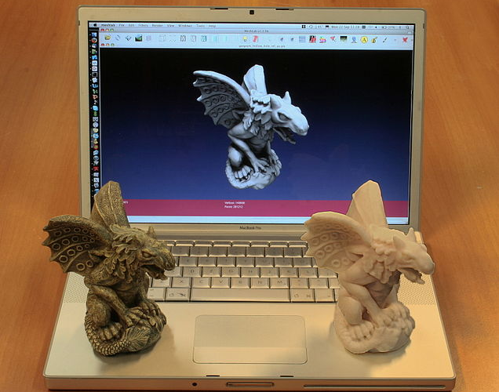
Where’s Depth Mapping Used?
Notes:
3D modelling is a popular application of depth mapping, even more popular with the advent of DIY 3D printers, such as the Reprap

Slide 3
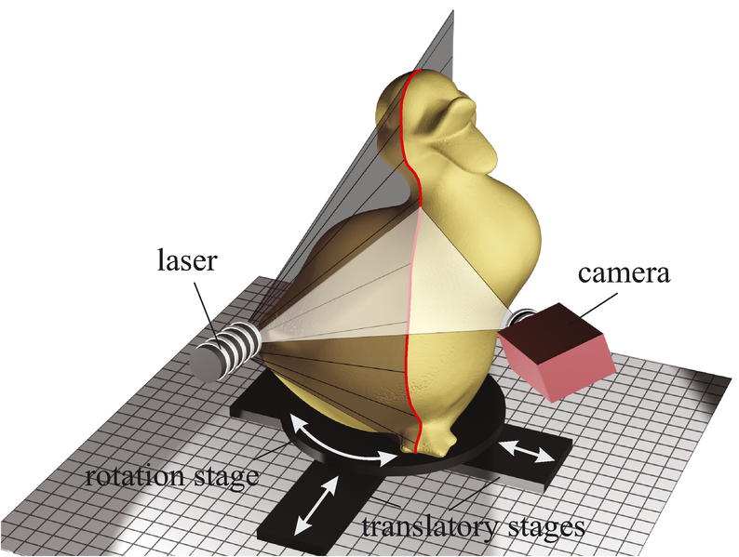
Where’s Depth Mapping Used?
Notes:
“Scanning” a physical 3D object can use an apparatus like such, which spins the object around while shining a laser on it

Slide 4
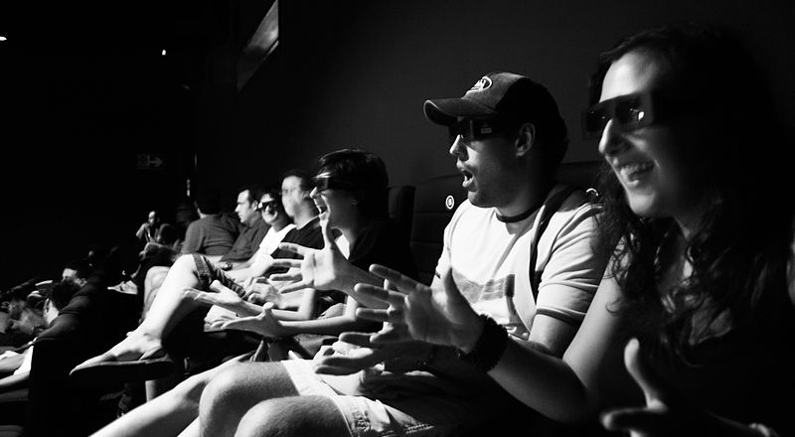
Where’s Depth Mapping Used?
Notes:
3D movies are becoming more and more popular

Slide 5
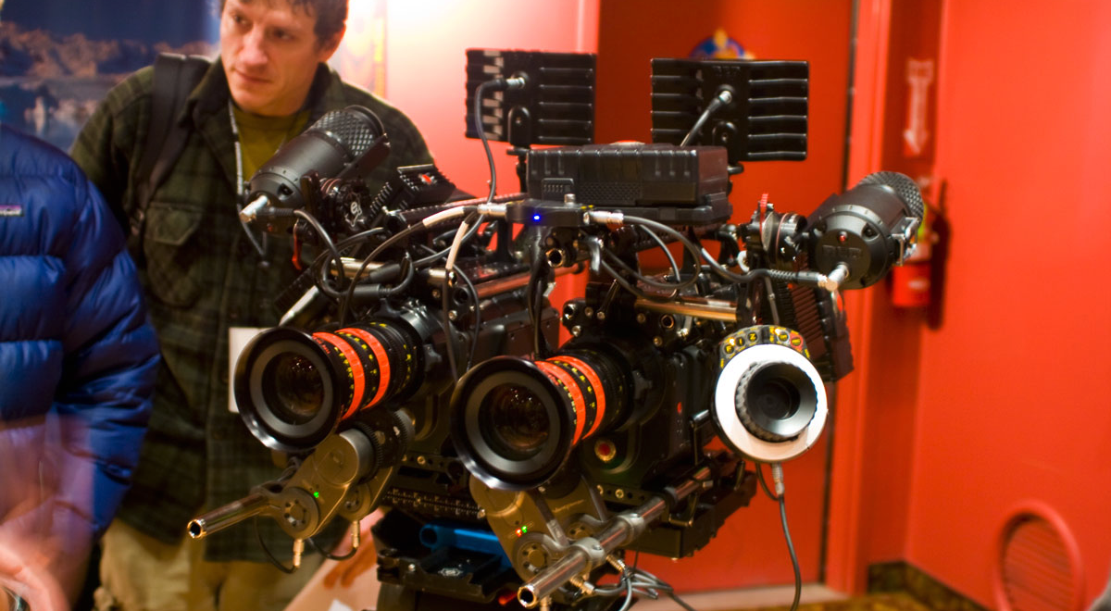
Where’s Depth Mapping Used?
Notes:
The RED 3D camera, used to film several blockbuster 3D films

Slide 6
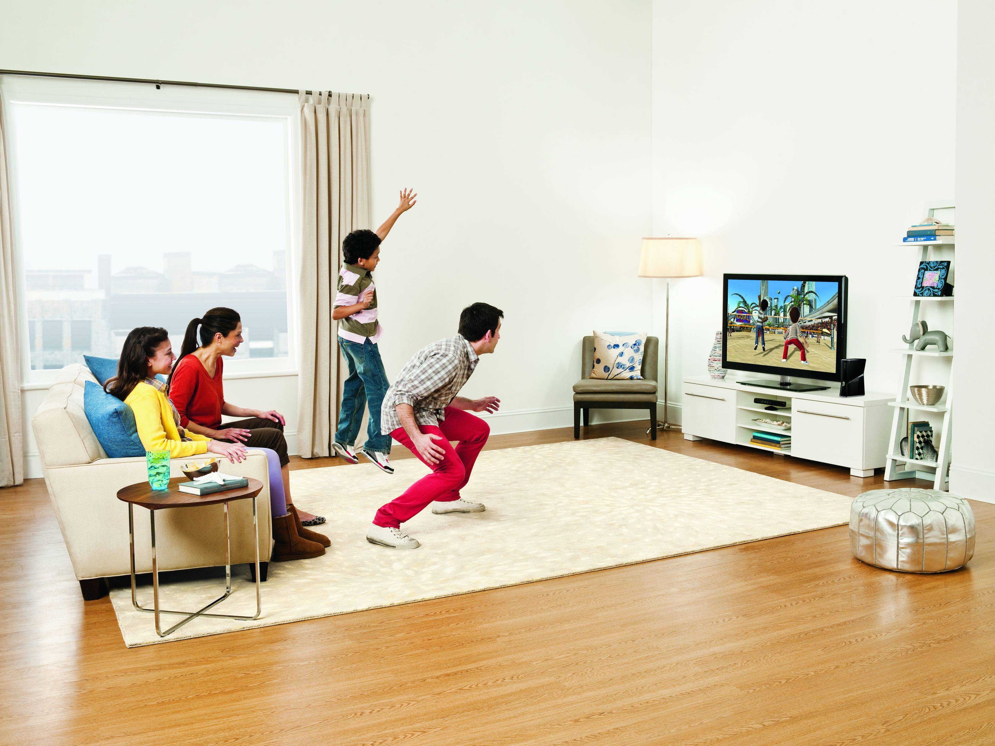
Where’s Depth Mapping Used?
Notes:
Xbox Kinect brings depth mapping to consumer applications to detect gestures and body movements

Slide 7
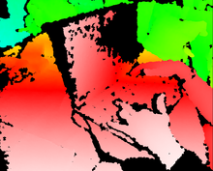
What do these have in common?
Notes:
They all generate depth information!

Slide 8
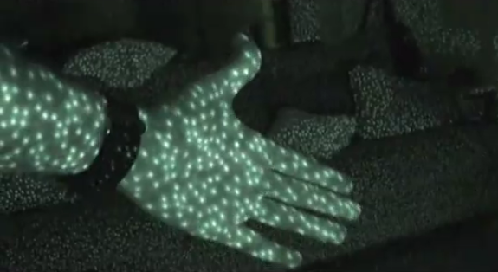
Ways of Implementing Depth Mapping
Notes:
Light-based depth mapping, which shines a laser on a scene and measures how the scene responds to it (such as the size of the laser dots)

Slide 9
Ways of Implementing Depth Mapping
Notes:
Stereoscopic depth mapping, which uses two fixed cameras. Uses distances of corresponding points and information about the cameras (such as the distance and field of view angle) to triangulate the distance of the object from the camera

Slide 10
Ways of Implementing Depth Mapping
Notes:
The RED 3D camera, used to film several blockbuster 3D films

Slide 11
Wait, I thought this was Image Recognition!
Stereoscopic Depth Mapping is a computer vision problem
However, we can apply image recognition techniques to solve a few problems within stereoscopic depth mapping.

Slide 12
Matching Corresponding Points

Slide 13
Lessons Learned
Corresponding points is HARD – and we’re only trying to solve a specific subset!
Corresponding a lot of points is even harder – especially in areas without a lot of texture or variation
MATLAB can be treacherous to optimize

Slide 14
Questions? Comments? Concerns? Interesting Anecdotes?

